Slide 1

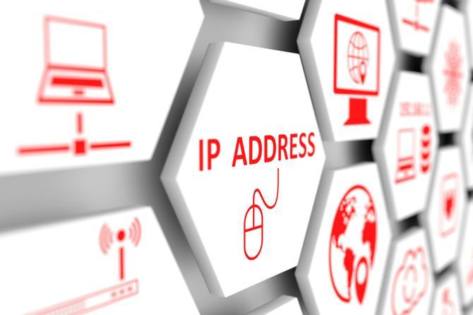
IP Addressing

Slide 2
What is?
An Internet Protocol (IP) address is a unique numerical identifier for every device or network that connects to the Internet.
It enables your device to send or receive data packets across the Internet.
Notes:
All the computers of the world on the Internet network communicate with each other with underground or underwater cables or wirelessly. If I want to download a file from the internet or load a web page or literally do anything related to the internet, my computer must have an address so that other computers can find and locate mine in order to deliver that particular file or webpage that I am requesting. In technical terms, that address is called IP Address or Internet Protocol Address.
Let us understand it with another example, like if someone wants to send you a mail then he/she must have your home address. Similarly, your computer too needs an address so that other computers on the internet can communicate with each other without the confusion of delivering information to someone else’s computer. And that is why each computer in this world has a unique IP Address. Or in other words, an IP address is a unique address that is used to identify computers or nodes on the internet. This address is just a string of numbers written in a certain format.

Slide 3
How are IP Addresses Generated?
IP addresses are generated automatically using an integrated algorithm by the Internet of Assigned Numbers Authority (IANA).

Slide 4
How are IP Addresses Generated?
IANA then allocates IP address blocks to Regional Internet Registries (RIRs) who in turn geographically distribute these blocks to Internet Service Providers (ISPs).

Slide 5
How are IP Addresses Generated?
The ISP generate individual IP addresses for their customers, ISPs typically use a technique called DHCP.
DHCP allows devices to have an IP address assigned automatically when they connect to a network.

Slide 6
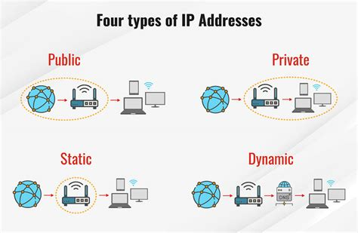

Slide 7
Public IP Addresses
A public IP address is an address where one primary address is associated with your whole network. In this type of IP address, each of the connected devices has the same IP address.
This type of public IP address is provided to your router by your ISP.

Slide 8
Private IP Addresses
A private IP address is a unique IP number assigned to every device that connects to your home internet network, which includes devices like computers, tablets, smartphones, which is used in your household.

Slide 9
Dynamic IP address
Dynamic IP addresses always keep changing. It is temporary and are allocated to a device every time it connects to the web.

Slide 10
Static IP Addresses
A static IP address is an IP address that cannot be changed.

Slide 11
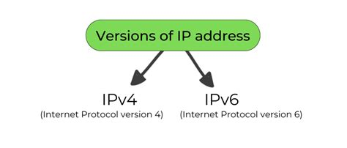
Version of IP address

Slide 12
IPV4
IPv4 was the first version of IP.
It was deployed for production in the ARPANET in 1983.
Today it is the most widely used IP version.

Slide 13
IPV4
It is used to identify devices on a network using an addressing system.
The IPv4 uses a 32-bit address scheme allowing to store 2^32 addresses, which is more than 4 billion addresses.

Slide 14
IPV4
To date, it is considered the primary Internet Protocol and carries 94% of Internet traffic.

Slide 15
IPV6
It is the most recent version of the Internet Protocol.
Internet Engineer Taskforce initiated it in early 1994.
This new IP address version is being deployed to fulfill the need for more Internet addresses.

Slide 16
IPV6
It was aimed to resolve issues which are associated with IPv4.
With 128-bit address space, it allows 340 undecillion unique address space.

Slide 17
IPv4 Representation
The IPv4 address is a 32-bit number.
An IPv4 address is written in decimal digits, formatted as four 8-bit fields that are separated by periods.
Each 8-bit field represents a byte of the IPv4 address and called as octets.

Slide 18
IPv4 Representation
IPv4 address is often referred to as the dotted-decimal format.
The bytes of the IPv4 address are further classified into two parts:
the network part
the host part

Slide 19
IPv4 Representation
Network Part
The network part specifies the unique number that is assigned to your network. The network part also identifies the class of network that is assigned.

Slide 20
IPv4 Representation
Host Part
This is the part of the IPv4 address that you assign to each host. The host part uniquely identifies this machine on your network.

Slide 21
IPv4 address classes
The 32-bit IP address is divided into five sub-classes. These are:
Class A
Class B
Class C
Class D
Class E

Slide 22
IPv4 address classes
Primarily, class A, B, and C are used by the majority of devices on the Internet.
Classes D and E are reserved for multicast and experimental purposes respectively.

Slide 23
IPv4 address classes
The class of IP address is used to determine the bits used for network ID and host ID and the number of total networks and hosts possible in that particular class.

Slide 24
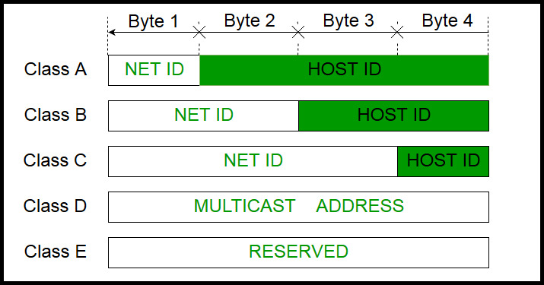
IPv4 address classes

Slide 25
Class A
IP addresses belonging to class A are assigned to the networks that contain a large number of hosts.
The network ID is 8 bits long.
The host ID is 24 bits long.

Slide 26
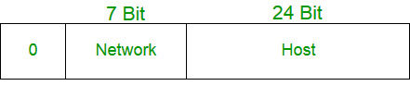
Class A
The higher-order bit of the first octet in class A is always set to 0.
The remaining 7 bits in the first octet are used to determine network ID.

Slide 27
Class A
The 24 bits of host ID are used to determine the host in any network.
The default subnet mask for Class A is 255.x.x.x.

Slide 28
Class A
Therefore, class A has a total of:
2^24 – 2 = 16,777,214 host ID
IP addresses belonging to class A ranges from 1.0.0.0 – 126.255.255.255.

Slide 29
Class B
IP address belonging to class B is assigned to networks that range from medium-sized to large-sized networks.
The network ID is 16 bits long.
The host ID is 16 bits long.

Slide 30
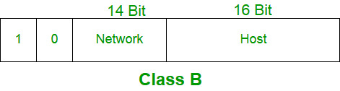
Class B
The higher-order bits of the first octet of IP addresses of class B are always set to 10.
The remaining 14 bits are used to determine the network ID.

Slide 31
Class B
The 16 bits of host ID are used to determine the host in any network.
The default subnet mask for class B is 255.255.x.x.

Slide 32
Class B
Therefore, class B has a total of:
2^14 = 16384 network address
2^16 – 2 = 65534 host address
IP addresses belonging to class B ranges from 128.0.0.0 – 191.255.255.255.

Slide 33
Class C
IP addresses belonging to class C are assigned to small-sized networks.
The network ID is 24 bits long.
The host ID is 8 bits long.

Slide 34
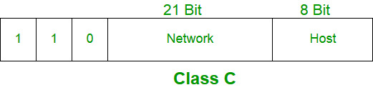
Class C
The higher-order bits of the first octet of IP addresses of class C is always set to 110.
The remaining 21 bits are used to determine the network ID.

Slide 35
Class C
he 8 bits of host ID are used to determine the host in any network.
The default subnet mask for class C is 255.255.255.x.

Slide 36
Class C
Therefore, class C has a total of:
2^21 = 2097152 network address
2^8 – 2 = 254 host address
IP addresses belonging to class C ranges from 192.0.0.0 – 223.255.255.255.

Slide 37
Class D
IP address belonging to class D is reserved for multi-casting.
The higher-order bits of the first octet of IP addresses belonging to class D is always set to 1110.

Slide 38
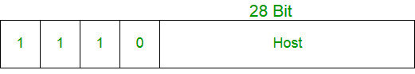
Class D
The remaining bits are for the address that interested hosts recognize.

Slide 39
Class D
Class D does not possess any subnet mask.
IP addresses belonging to class D range from 224.0.0.0 – 239.255.255.255.

Slide 40
Class E
IP addresses belonging to class E are reserved for experimental and research purposes.
IP addresses of class E range from 240.0.0.0 – 255.255.255.254.

Slide 41
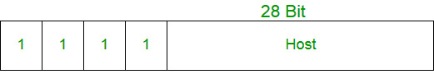
Class E
This class doesn’t have any subnet mask. The higher-order bits of the first octet of class E are always set to 1111.

Slide 42
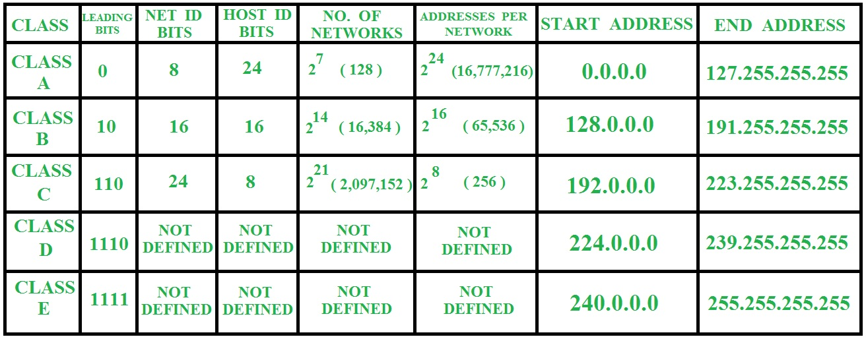
Summary of Classful Addressing

